Slide 1

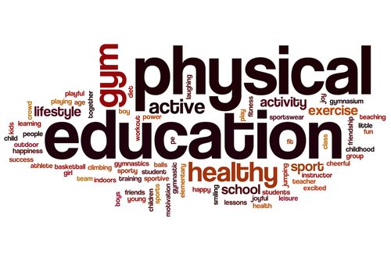

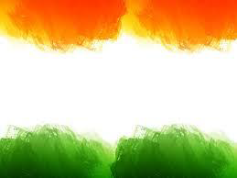
SHRI GURU GOBIND SINGH JI GOVT. COLLEGE,
PAONTA SAHIB, SIRMOUR (H.P)

Slide 2
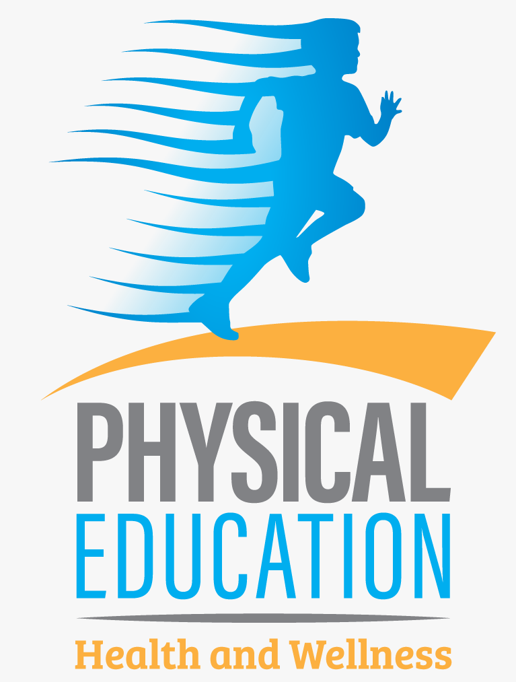
B.A. 2nd YEAR
COURSE NAME: HUMAN ANATOMY AND PHYSIOLOGY
COURSE CODE: PED201TH

Slide 3
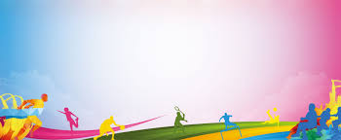
ANATOMY AND PHYSIOLOGY

Slide 4
TOPICS TO BE COVERED
MEANING OF ANATOMY AND PHYSIOLOGY
SKELETAL SYSTEM
FUNCTIONS OF SKELETON SYSTEMS
MUSCLES
FUNCTIONS OF MUSCLES
MUSCLE TYPES

Slide 5
MEANING OF ANATOMY AND PHYSIOLOGY
Anatomy refers to the internal and external structures of the body and their physical relationships, whereas physiology refers to the study of the functions of those structures.
Anatomy and physiology is the study of the body's systems and structures and how they interact. Anatomy focuses on the physical arrangement of parts in the body, while physiology studies the inner functioning of cells, tissues, and organs.

Slide 6
SKELETAL SYSTEM
The skeletal system is your body’s central framework. It consists of bones and connective tissue, including cartilage, tendons, and ligaments. It’s also called the musculoskeletal system.

Slide 7
FUNCTIONS OF SKELETON SYSTEMS
The skeletal system has many functions. Besides giving us our human shape and features, it:
Allows movement: Your skeleton supports your body weight to help you stand and move. Joints, connective tissue and muscles work together to make your body parts mobile.
Produces blood cells: Bones contain bone marrow. Red and white blood cells are produced in the bone marrow.
Protects and supports organs: Your skull shields your brain, your ribs protect your heart and lungs, and your backbone protects your spine.
Stores minerals: Bones hold your body’s supply of minerals like calcium and vitamin D.

Slide 8
MUSCLES
Muscles are soft tissues. Many stretchy fibers make up your muscles. You have more than 600 muscles in your body.
Different types of muscles have different jobs.
Some muscles help you run, jump or perform delicate tasks like threading a needle.
Other muscles allow you to breathe or digest food. Your heart is a hard-working muscle that beats thousands of times a day.
Many disorders, injuries and diseases can affect how muscles work. These conditions can cause muscle pain, muscle spasms or muscle weakness.
More severe disorders can lead to paralysis.
Cardiomyopathy and other kinds of heart disease make it difficult for the heart to pump blood through the body.
Living a healthy lifestyle helps your muscles work like they should.
You can keep your muscles strong by maintaining a healthy weight, eating a balanced diet and getting plenty of exercise.
Be sure to see your provider regularly to screen for diseases and conditions that can lead to muscle problems.

Slide 9
FUNCTIONS OF MUSCLES
Breathing, speaking and swallowing.
Digesting food and getting rid of waste.
Moving, sitting still and standing up straight.
Pumping blood through the heart and blood vessels.
Pushing a baby through the birth canal as muscles in the uterus contract and relax.
Seeing and hearing.

Slide 10
MUSCLE TYPES
In the body, there are three types of muscle: skeletal (striated), smooth, and cardiac.
  Skeletal Muscle
  Smooth Muscle
  Cardiac Muscle

Slide 11


